Slide 1
Radio Theory

Slide 2

Session Aims
To gain an understanding of what radio is and what it’s used for
Importance of radio in HAB
Why we need our own radio system
Line - of - sight
Frequency and wavelength
Types of aerial
Types of modulation
Sample radio trackers

Slide 3
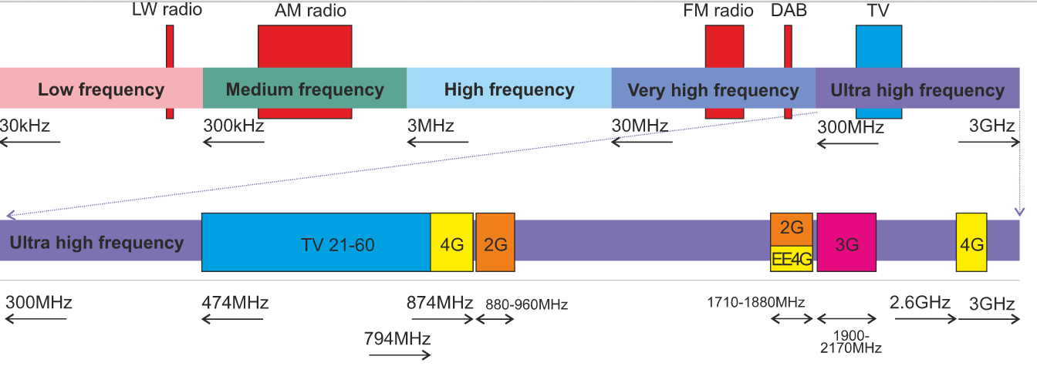
Radio Spectrum

Slide 4
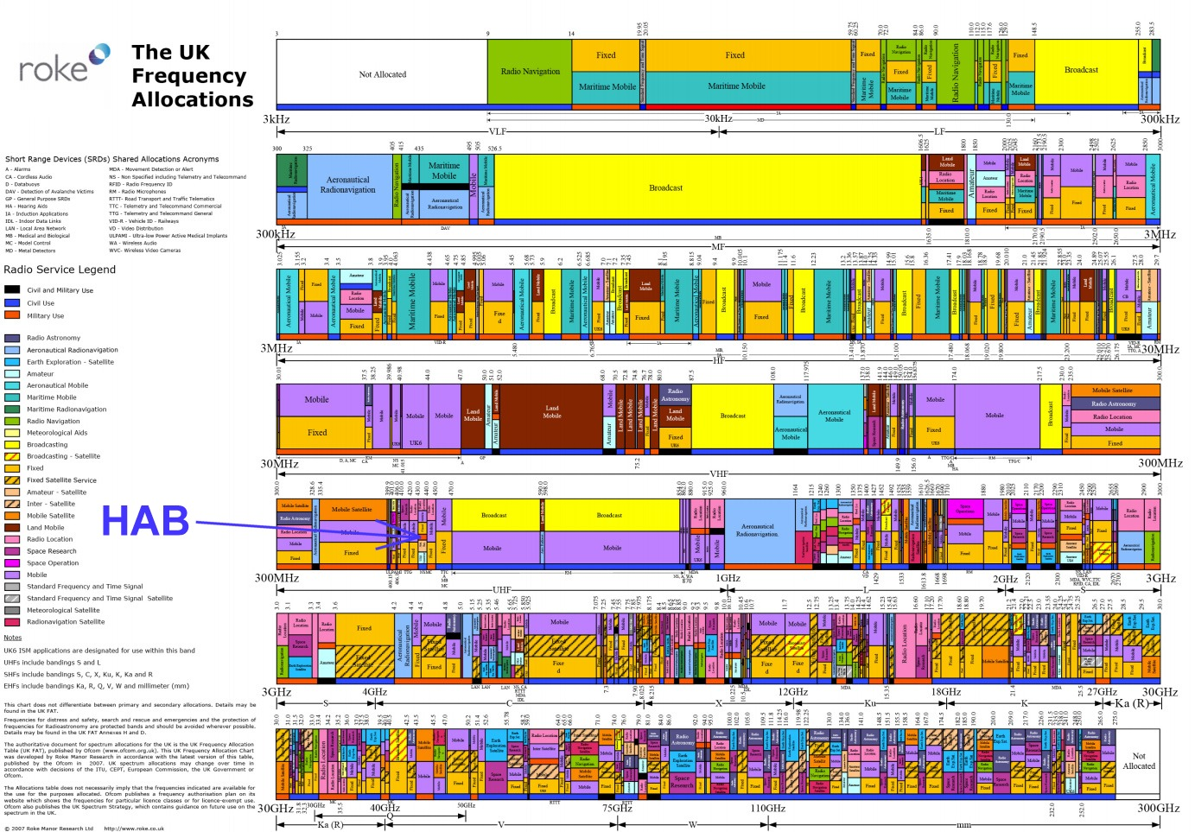

Slide 5
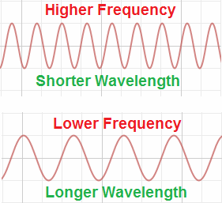
Frequency And Wavelength

Slide 6
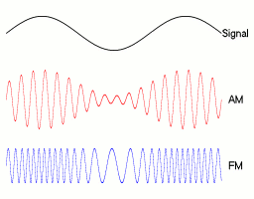
Radio Modulation
"Amfm3-en-de" by Berserkerus - Own work. Licensed under CC BY-SA 2.5 via Wikimedia Commons

Slide 7
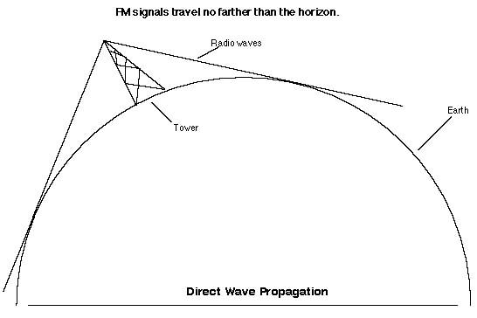
Radio Horizon

Slide 8
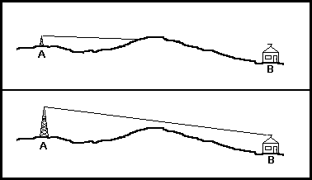
Local Obstructions

Slide 9
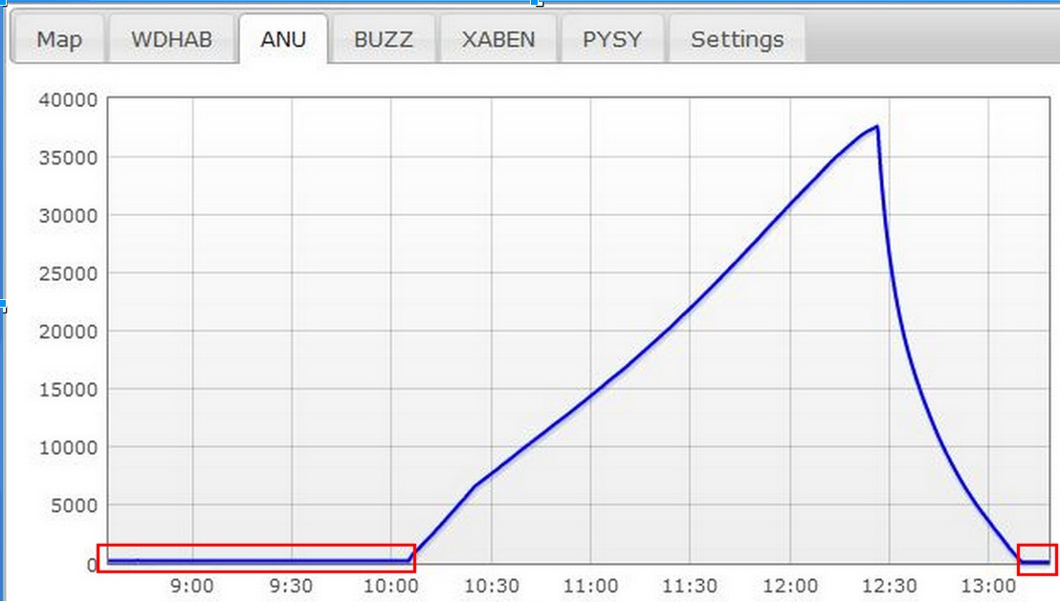
Flight Stages

Slide 10
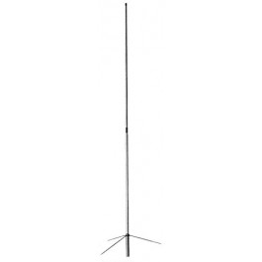
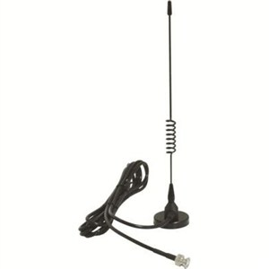
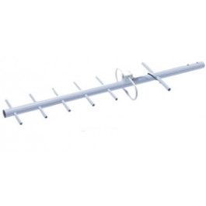
Aerials

Slide 11
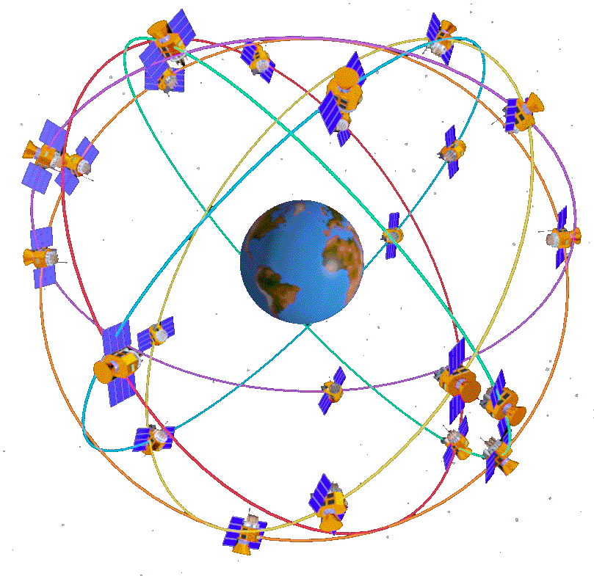
GPS

Slide 12

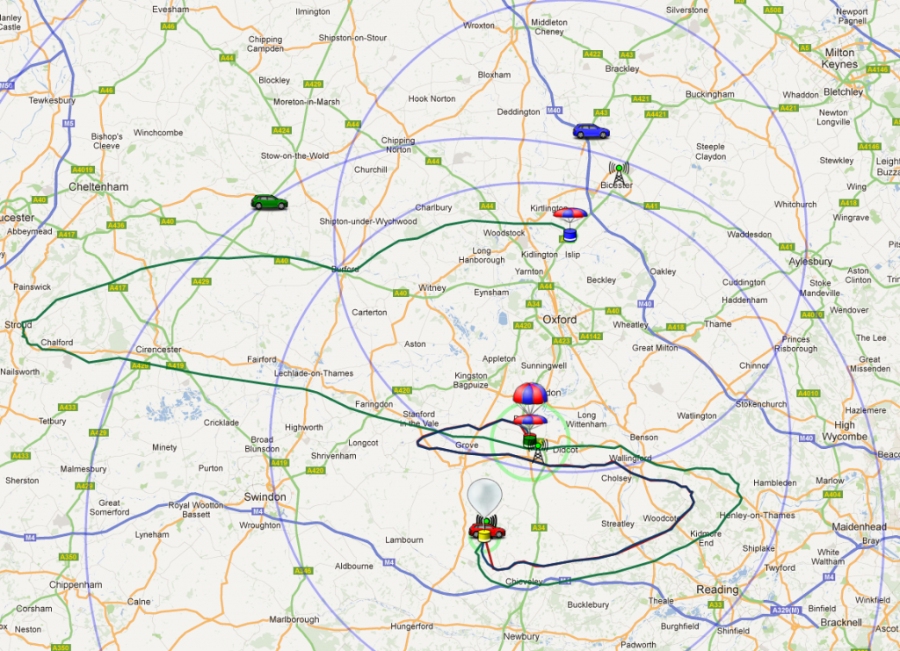
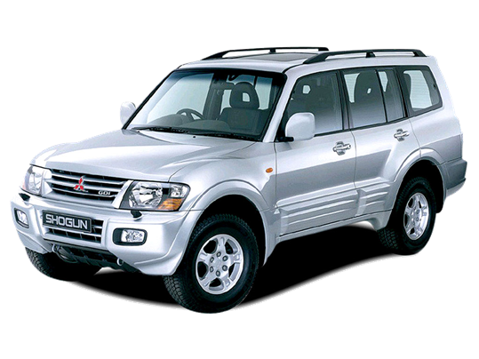


Distributed Tracking System

Slide 13
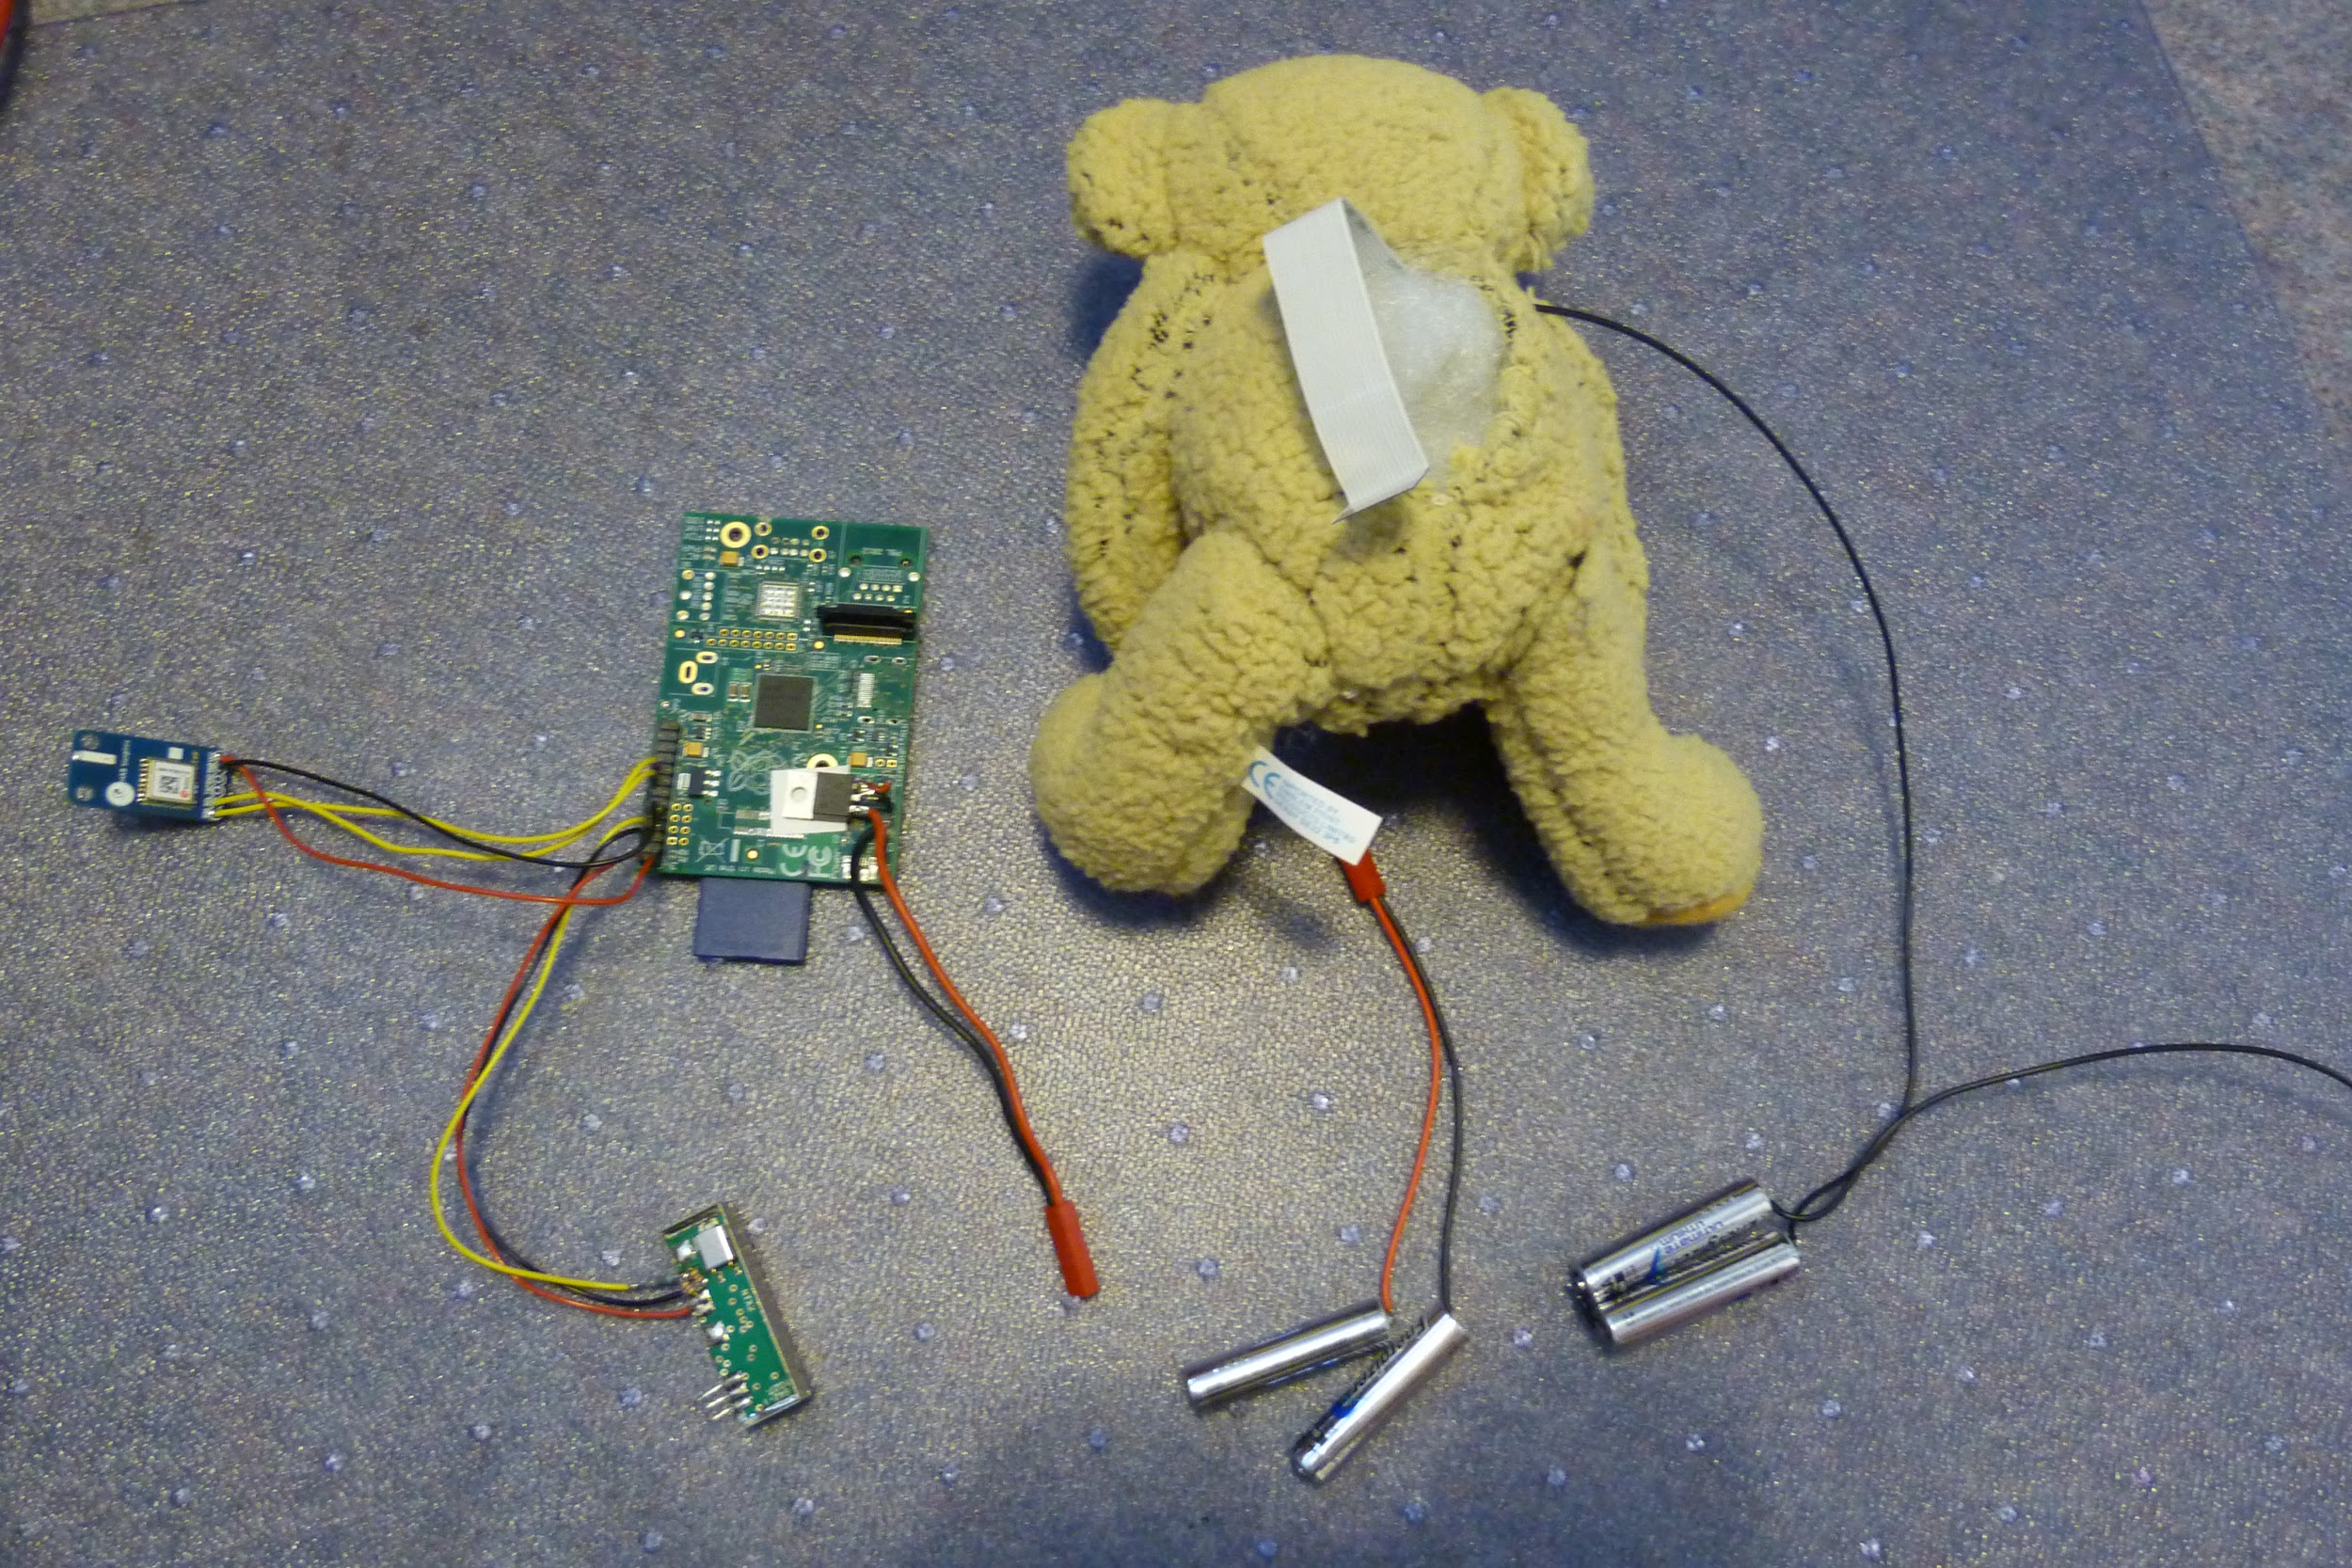
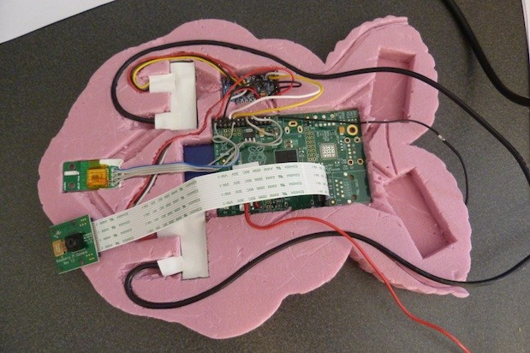
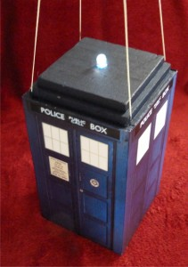
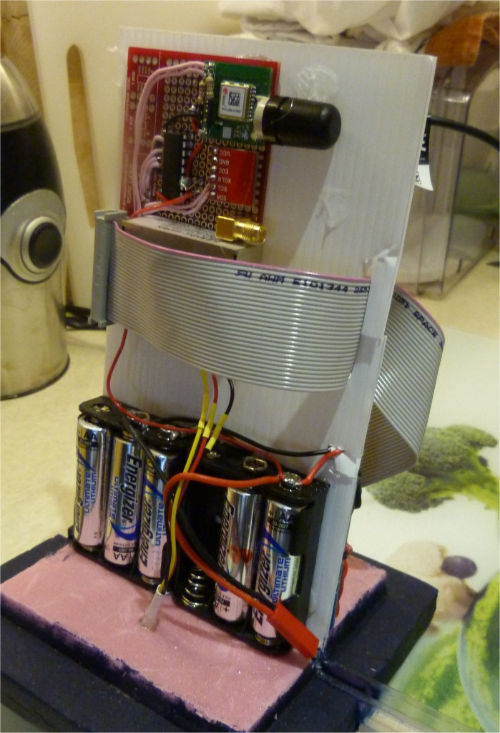
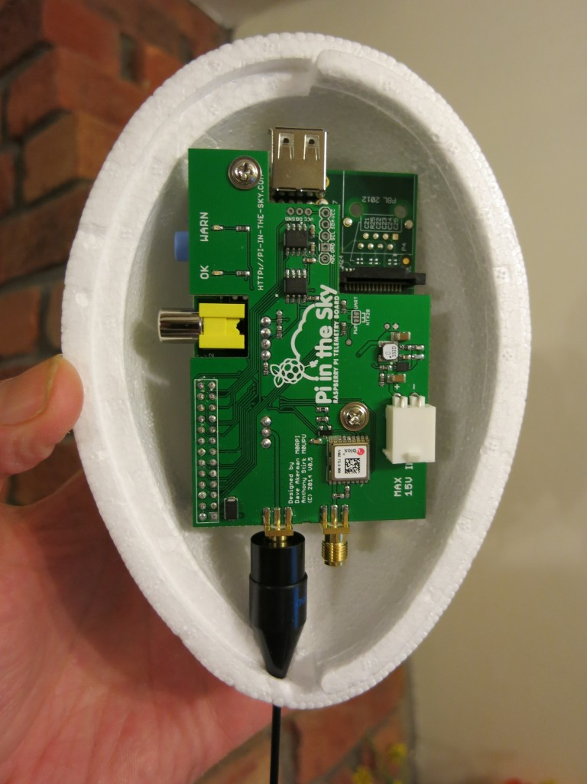
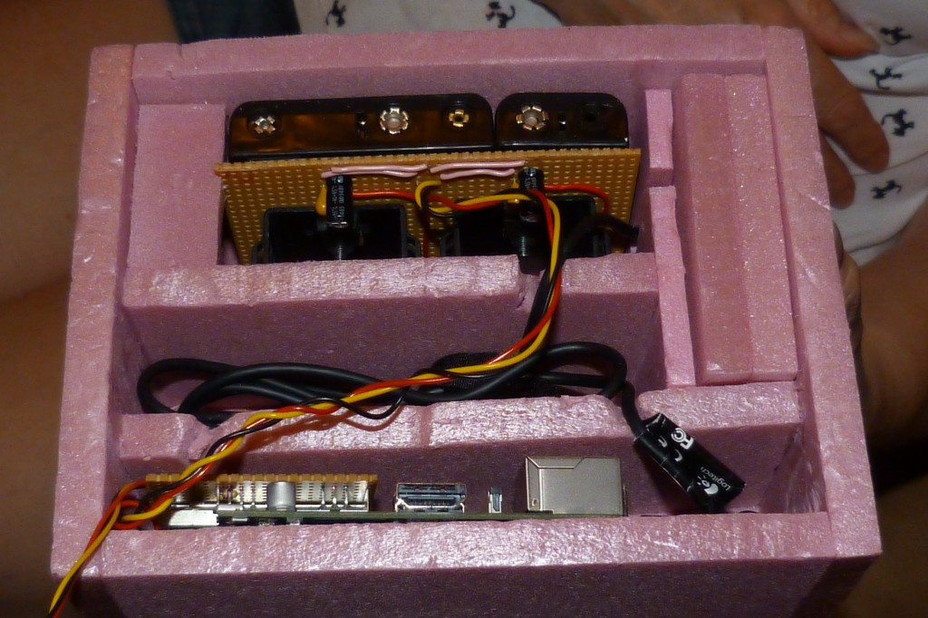
Complete GPS/Radio Tracker

Slide 14
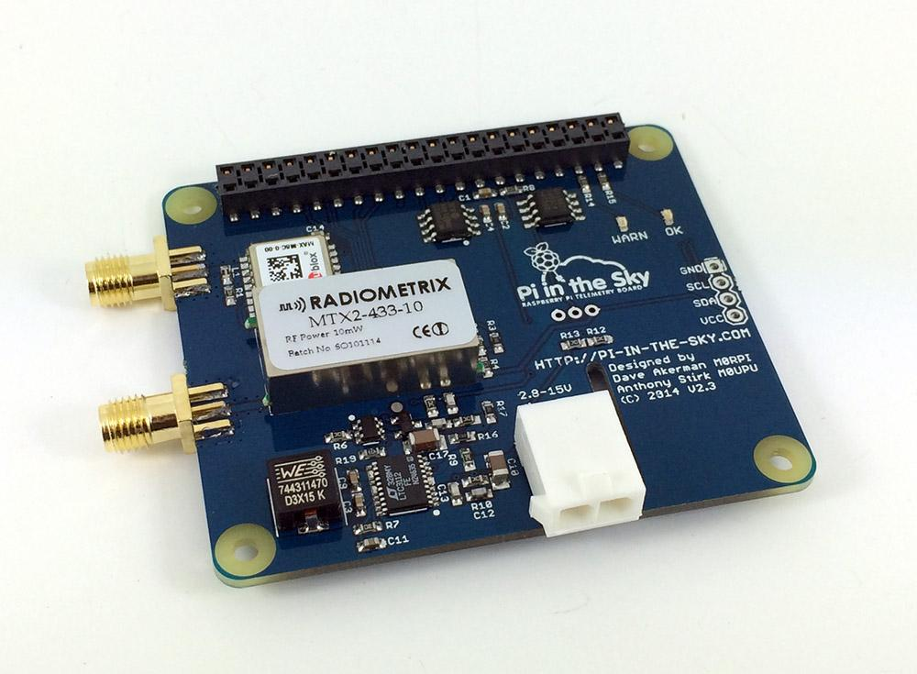
Commercial GPS/Radio Tracker

